Slide 1
Topic: Pythagoras Theorem
EQ: How can I use Pythagoras Theorem to solve problems in 3-D?

Slide 2
Topic: Pythagoras Theorem EQ: How can I use Pythagoras Theorem to solve problems in 3-D?
Summary:

Slide 3
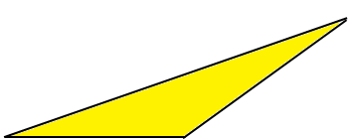
Topic: Pythagoras Theorem EQ: How can I use Pythagoras Theorem to solve problems in 3-D?
C
Cuboid Question
H
G
D
6cm
E
C
F
3cm
6cm
A
5cm
B
A
5cm
B
Find Length AG
First: Find length AC using Pythagoras
AC = √5²+6² = 7.8cm

Slide 4
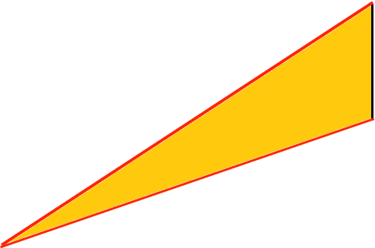
Topic: Pythagoras Theorem EQ: How can I use Pythagoras Theorem to solve problems in 3-D?
H
G
D
E
C
F
3cm
3cm
6cm
A
5cm
B
7.8cm
Next: Find Length AG
AG = √3²+7.8² = 8.4cm

Slide 5
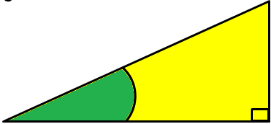

Topic: Pythagoras Theorem EQ: How can I use Pythagoras Theorem to solve problems in 3-D?
Find Angle CAG
H
G
D
E
C
F
3cm
3cm
6cm
A
5cm
B
7.8cm
Find length AC as before then find the angle as:
3
7.8
tan⁻¹
= 21º

Slide 6
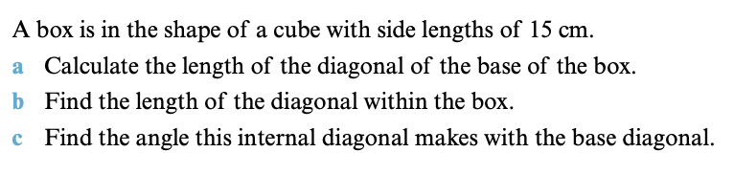
Your Turn

Slide 7
Topic: Pythagoras Theorem EQ: How can I use Pythagoras Theorem to solve problems in 3-D?
Square Based Pyramid Question
This is a square based
pyramid, where the
lengths of the sides of
the square are 20.6cm
and the
height is 14.75cm
X is the middle of the
square base
E
Find Length AE
14.75
D
C
X
20.6cm
A
20.6cm
B

Slide 8

Topic: Pythagoras Theorem EQ: How can I use Pythagoras Theorem to solve problems in 3-D?
First: Find length AC using Pythagoras
Find Length AE
E
AG = √20.6²+20.6² = 29.1cm
C
20.6cm
14.75
D
C
A
20.6cm
B
X
20.6cm
A
20.6cm
B

Slide 9
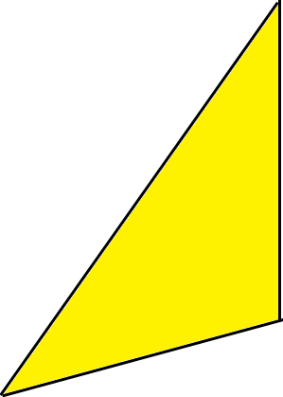
Topic: Pythagoras Theorem EQ: How can I use Pythagoras Theorem to solve problems in 3-D?
Next: Find Length AE using Pythagoras
E
E
14.75cm
14.75
D
C
A
14.6cm
X
X
29.1cm
Note: ½ of AC ½ x 29.1 = 14.6
AG = √14.6²+14.75² = 20.8cm
A
20.6cm
B

Slide 10
Topic: Pythagoras Theorem EQ: How can I use Pythagoras Theorem to solve problems in 3-D?
Find the angle AE makes with the base
E
E
14.75cm
14.75
D
C
A
14.6cm
X
A
X
Angles given to a suitable degree of accuracy
To the nearest whole number
29.1cm
tan⁻¹
14.75
14.6
= 45º
A
20.6cm
B

Slide 11
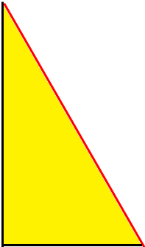
Topic: Pythagoras Theorem EQ: How can I use Pythagoras Theorem to solve problems in 3-D?
Find the length EM where M is the midpoint of BC
E
E
Make triangle EXM
14.75cm
14.75
D
C
X
M
M
X
10.3cm
20.6cm
Note: ½ of BC ½ x 20.6 = 10.3
A
20.6cm
B
AG = √20.6²+14.75² = 25.3cm

Slide 12

Topic: Pythagoras Theorem EQ: How can I use Pythagoras Theorem to solve problems in 3-D?
Find the angle that the face EBC makes with the base
E
E
14.75
14.75
D
C
X
M
X
10.3cm
M
10.3cm
A
tan⁻¹
14.75
10.3
B
= 55º

Slide 13
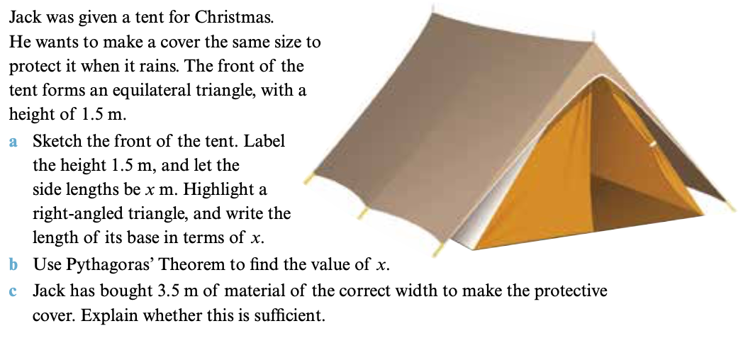
Your Turn

Slide 14
Topic: Pythagoras Theorem EQ: How can I use Pythagoras Theorem to solve problems in 3-D?
Homework: Pythag with 3D Worksheet
Complete your summary
Summary:

